Slide 1


Workshop on evaluating vaccine impact Evaluating Vaccine Impact using Time Series Data
Dan Weinberger, PhD
Epidemiology of Microbial Diseases
Yale School of Public Health

Slide 2
Acknowledgements
The development of this workshop was supported by a grant from the Bill and Melinda Gates Foundation
The material in this workshop was jointly developed with
Dr. Kayoko Shioda (Yale/Emory)
Iris Artin
Dr Cristiana Toscano (PAHO/Universidade Federal de Goiás)
Dr. Lucia Oliveria (PAHO)
Dr. Jackie Kleynhans (NICD/South Africa)
Dr. Nuredin Mohammed (MRC/Gambia)
Dr. Lone Simonsen (Roskilde)
Dr. Rob Taylor (Sage Analytica)
Dr. Cynthia Schuck-Paim (Sage Analytica)
Dr. Christian Bruhn
The WHO working group on the use of administrative data to evaluate PCV impact (Fernanda Lessa (CDC), Jennifer Loo Farrar (CDC), Tomoka Nakamura (WHO), Adam Cohen (WHO/CDC)

Slide 3
Conflicts of interest
I am PI on grants from Merck and Pfizer to Yale
I consult for Pfizer, Merck, GSK, Affinivax and Matrivax, all of whom are producing or developing pneumococcal vaccines

Slide 4
In this presentation
What do we mean by ‘vaccine impact’?
What are some common data sources that can be used,
Administrative data and its pitfalls?

Slide 5
Types of studies to evaluate vaccines using real-world data
Evaluating direct effect of a vaccine
on an individual’s risk of disease
A: Case, unvaccinated
Case-control studies (also: test negative case-control)
V
B: Case, vaccinated
V
V
V
C: Control, unvaccinated
V
V
V
D: Control, vaccinated
V
V
V
Vaccine effectiveness: 100* (1-(B/A)/(D/C))
Vaccine effectiveness: 100* (1-(3/4)/(5/2))=70%

Slide 6

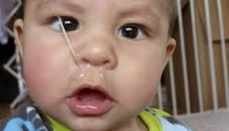

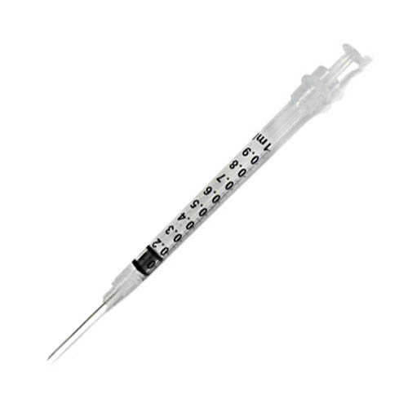
Quantifying the impact of vaccines
For many vaccines, the public health benefit depends on both the direct effect and indirect effect that results from blocking transmission
To quantify this total benefit of the vaccine we need to evaluate changes in aggregate rates of disease that occur after vaccine introduction
Vaccine impact= direct+indirect effects of the vaccines
To do this, we perform time series analysis to quantify declines in disease rates following introduction of vaccine
http://theroadtodomestication.com/wp-content/uploads/2015/07/IMG_6746-1565.jpg
https://i2.wp.com/www.lifewithgremlins.com/wp-content/uploads/2014/07/holy-snot.jpg?zoom=2.625&fit=570%2C363&ssl=1&resize=166%2C95

Slide 7
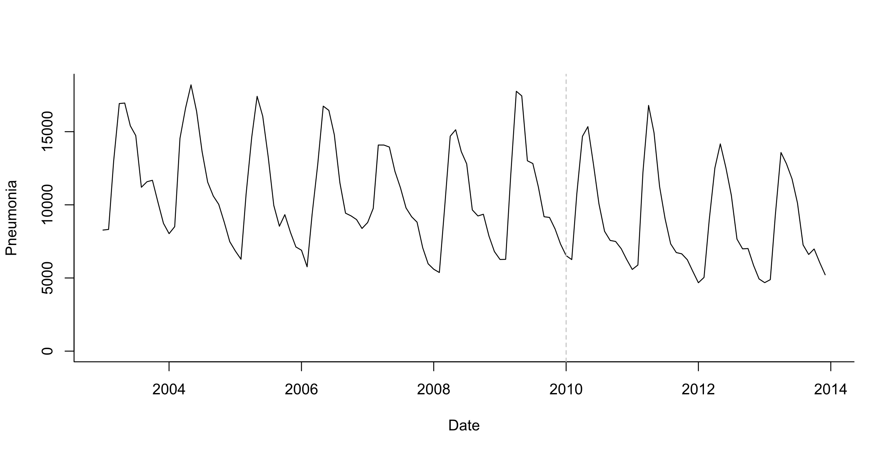
What is a time series?
Number of cases per week/month/year
A monthly time series of pneumonia cases in infants in Brazil
Number of events
Time (in months)

Slide 8
Simple case: is there a change following vaccine introduction?
A monthly time series of pneumonia cases in infants in Brazil
Number of events
Is there a decline?
Time (in months)

Slide 9
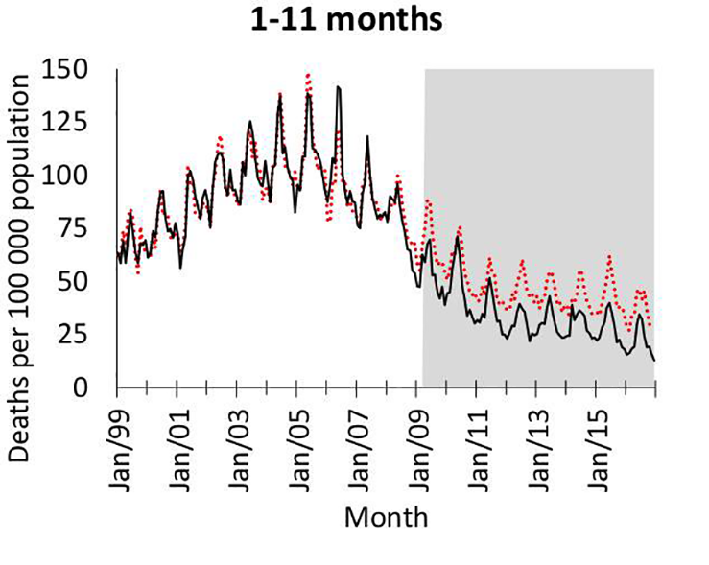
What could go wrong?
Pneumonia deaths in S. Africa
Changes in diagnostic/referral patterns that coincide with vaccine introduction
Changes in underlying health of the population that coincide with vaccine introduction
Unexplained linear and non-linear trends
Non-endemic diseases with unpredictable dynamics (e.g., COVID-19)
Kleynhans, et al PLOS Medicine

Slide 10
What else could go wrong with analyses?
Epidemic before or after vaccine introduction (biases slope estimates)
Ie 2009 pandemic, then introduce PCV in 2010
Insufficient data in pre- or post-period to accurately estimate trend
Delayed rollout of vaccine/low uptake
Many, many other issues that you can’t predict…

Slide 11
Defining the study question: PICO
P - the target population in which the impact of the intervention is to be measured
I - the intervention and date of intervention
C - the comparator (disease or group of diseases to which the outcome will be compared with), which is not expected to be impacted by the intervention
O - the outcome of interest, i.e., what is the condition being evaluated that is expected to be impacted by the intervention

Slide 12
Defining the study question: PICO
P - the target population Children 2-59 months in Brazil
I - the intervention Introduction of PCV10 in the national immunization program in 2010
C - the comparator To be discussed…
O - the outcome of interest Deaths due to pneumonia
And what data sources do we have to evaluate these questions?

Slide 13
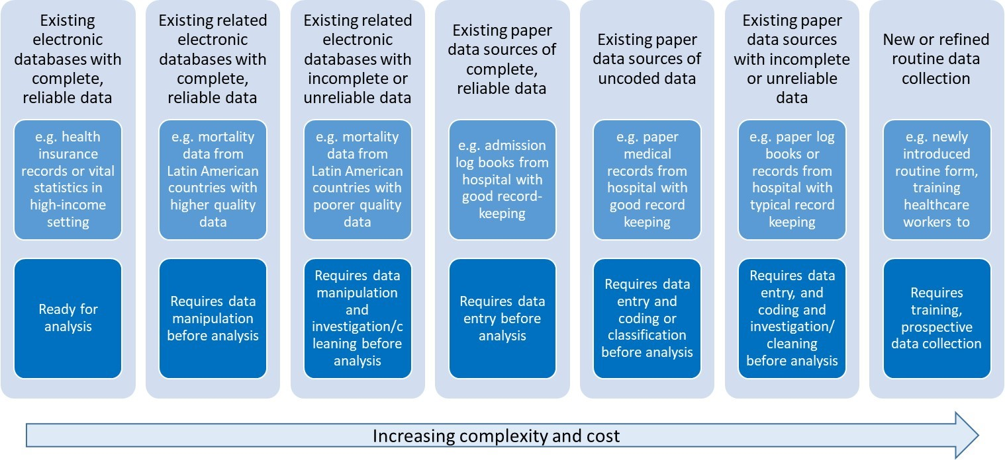
Types of data for evaluating vaccine impact
Jennifer Verani, Centers for Disease Control and Prevention – Kenya, slideset on “Using administrative data to measure PCV impact in Africa”

Slide 14
Common types of administrative data
National mortality registries
Hospital discharge data from a single hospital/region/nation
Insurance claims databases

Slide 15
Typical structure of administrative datasets
Age (y) | Date of admission | Region of residence | Cause 1 | Cause2…
3.2 | 2019-01-02 | NW | J129
1.5 | 2019-01-15 | NW | E101 | J189
7 | 2019-11-01 | S | J18
9 | 2019-12-01 | MW | J14
11 | 2019-12-15 | E | J13

Slide 16
Common issues with administrative data
Simple pre/post vaccine comparisons to evaluate importance of different potential biases
Use Brazil healthcare system as a test case

Slide 17
Denominators/offsets
Commonly defined as number of cases per capita (incidence)
N_cases/N_people*100,000
But often database doesn’t cover all of the population
Coverage might change over time
Might want to use:
Number of people using healthcare system
Number of people who are hospitalized
Number of people receiving some test (e.g., Xrays)
Population size
Number of hospitalizations
Hospitalization/Population

Slide 18
Effect of denominator on estimates
~70% of Brazilian population uses public healthcare (SUS)
Varies by region and declines over time

Slide 19
Denominators
Choose a denominator that reflects changes in potential confounders
Change in all-cause pneumonia 2011-12 vs 2008-09 when using different denominators
 | Total population | Population using public system | All-cause hospitalization
Brazil | .89 | .92 | 0.85

Slide 20
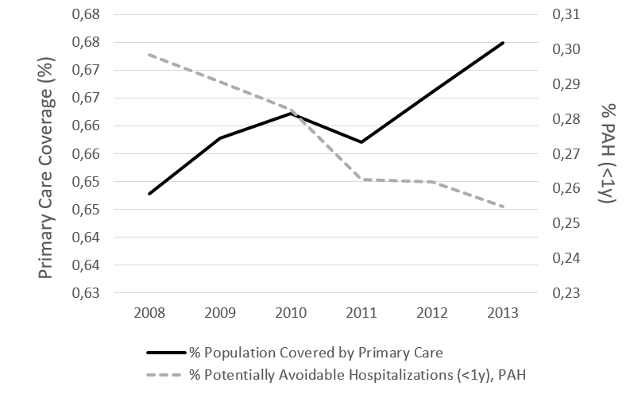
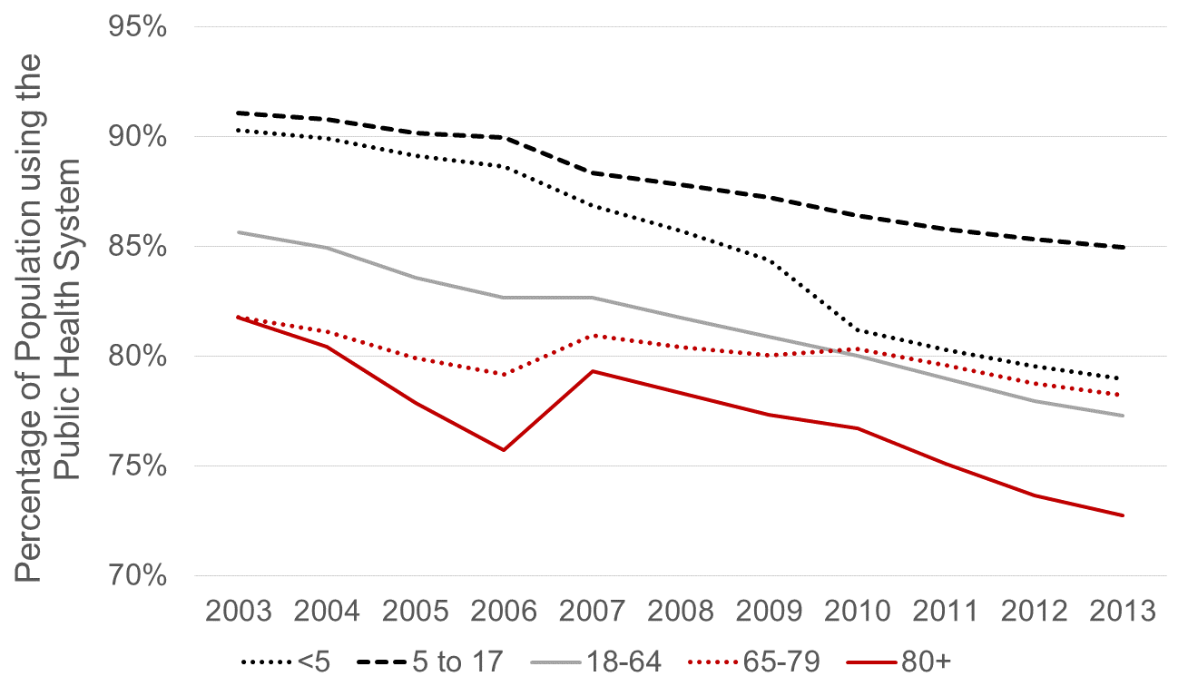
Many factors aside from vaccination can influence disease rates
Changes in access to primary care
Changes in use of public healthcare
Potentially-avoidable hospitalizations

Slide 21
Effect of improvements in primary care

Slide 22
Availability of hospital beds

Slide 23
Availability in hospital beds
More consistent (credible?) estimates

Slide 24
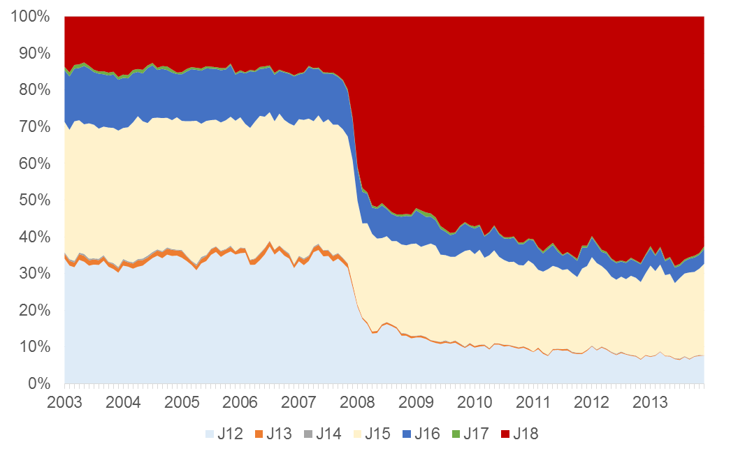
Changes in ICD coding practices
Changes in ICD coding
Pneumonia, unspecified

Slide 25
We have all of these problems with the data, now what?
Identify appropriate variables to control and adjust for these trends unrelated to the vaccine so that we can quantify the
effect of the vaccine

Slide 26
Summary
The goal in evaluations of ‘vaccine impact’ is to measure changes in rates of disease/death associated with vaccine introduction that reflect both direct and indirect effects of vaccines
Administrative data sources are commonly used for this type of analysis
Many things aside from vaccines can influence disease rates and we need tools to isolate the effect of the vaccine

Slide 27
Next up: Practical session 1: Data wrangling
How do we go from a raw line list of data from an administrative dataset to a clean time series using R?

